Slide 1
Part II and III
Things present by Mario
I glaube ebe github fonktioniert ned, wenn mer beidi ah de gliechlige slides schaffe…

Slide 2
Idea and Model
Model
Data
Gravity

Slide 3
Idea and Model
Model
Data
Gravity

Slide 4
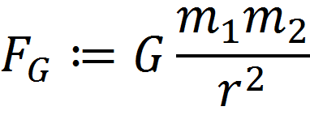
Gravity Model
Notes:
Well known formula

Slide 5
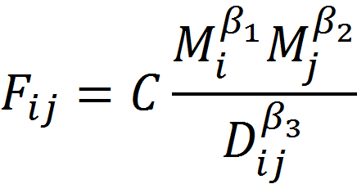
Gravity Model

Slide 6
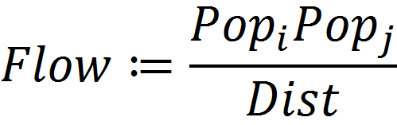
Gravity model
Notes:
Tell about 22 cities!

Slide 7
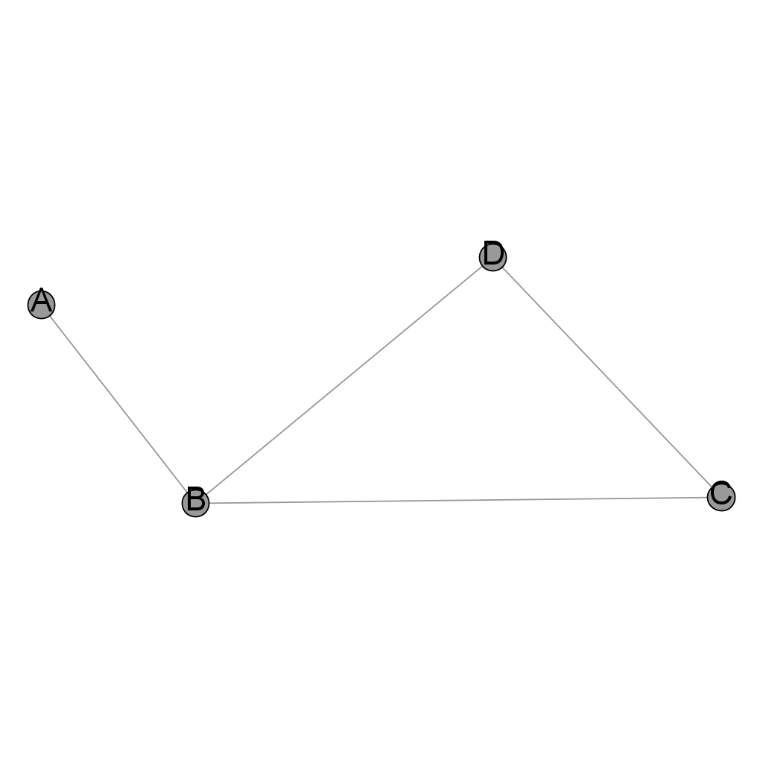
Adjacency matrix
Nodes | A | B | C | D
A | 0 | 1 | 0 | 0
B | 1 | 0 | 1 | 1
C | 0 | 1 | 0 | 1
D | 0 | 1 | 1 | 0
Notes:
Don‘t forget comment on weight

Slide 8
‚Real Network‘
Looked up connections
Not fully-connected

Slide 9
Shortest-Path

Slide 10
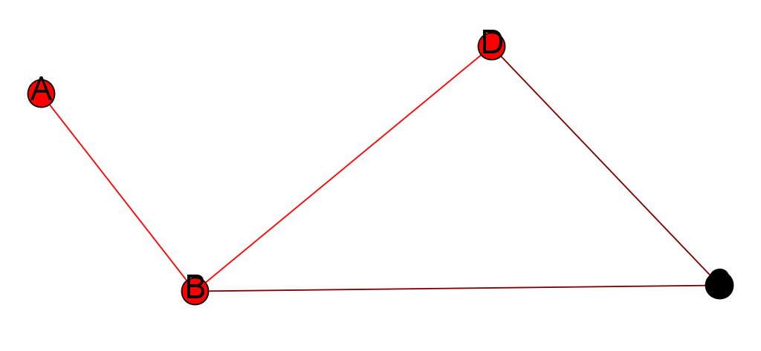
Shortest-Path

Slide 11
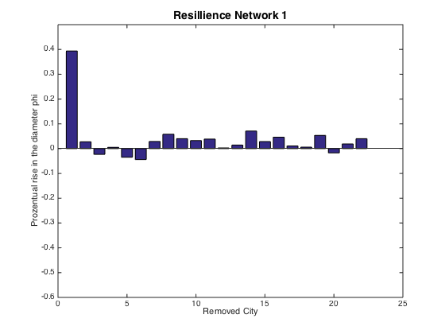
Resilience
Notes:
Comment on city vector!!! Beside Zürich very resistant (quite obvious), Zürich since it has so a huge population

Slide 12
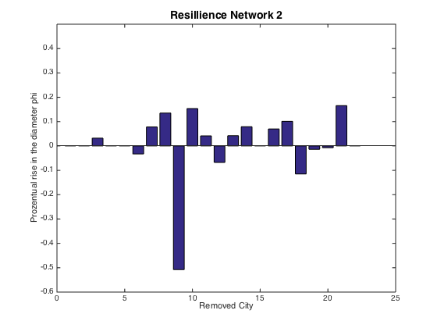
Resilience
Notes:
Remarkable effect when Lugano is removed, not every time still connect, not so resistant.

